Slide 1

Computer Engineering Department A.P. Shah Institute of Technology G.B.Road,Kasarvadavli, Thane(W), Mumbai-400615 UNIVERSITY OF MUMBAI Academic Year 2021-2022

Slide 2
Synopsis on Secerative Submitted in partial fulfillment of the degree of Bachelor of Engineering(Sem-3) in Computer Engineering By
Smit Mahesh Panchal (20102027) Ujjwal Rajendra Pal (20102054) Bhavesh Pawar (20102069) Amit Gopal Nara (20102067)
Under the Guidance of Name of Guide Prof.Ramya R.B.

Slide 3
Abstract
Nowadays in this modern world privacy has become a very important and necessary topic for the users of various applications and websites. The user’s concern towards his/her own online privacy is growing day by day.
Thus we need a tool to protect the privacy of the users by encrypting the data that the user’s don’t want to show to anyone accidentally. This is where our website Secerative comes in use. Our website provides options to encrypt text as well as file that the user want to keep secret.
Our website provides user options to either paste text in a textbox that they want to encrypt or upload the file that they want to encrypt , and then with a simple click they get the encrypted text or file thus helping to protect data of the user.

Slide 4
1.1 Problem Definition
Our project ICreate objective is to create an ID card for students and employees as instructed.
They can Design one side or both, add background images, include custom and system data using an idcard generator ID cards can be generated in bulk or individually for each user.
The primary goals and purposes are to reduce human effort and develop the automated id card.

Slide 5
1.2 Objectives
Encryption plays an important role in securing many different types of information technology (IT) assets. It provides the following:
Confidentiality - Confidentiality encodes the message's content.
Authentication - Authentication verifies the origin of a message.
Integrity - Integrity proves the contents of a message have not been changed since it was sent.

Slide 6
1.3 Scope
ID cards have become a crucial part of the business world, making it possible to simultaneously simplify employee and visitor identification and enhance a company’s integrity and security.
ID cards typically include an employee’s name, photo, job title and department, making quick personal identification a snap. As technology advances, however, ID cards are now being used in a variety of ways to help businesses protect themselves, build relationships and streamline their operations
ICreate will assure the security of your work and personal details. It will be accessible from anywhere and will be avaliable handy to everyone.

Slide 7
1.4 Existing System/project
There are some existing Encryption softwares which are both free as well as paid.
Some existing systems are –
Paid –
AxCrypt
Microsoft OneDrive
Free –
VeraCrypt
Folder Lock

Slide 8
2 Technology stack
Frontend – HTML , CSS and Javascript
Backend – python , php
Database - SQL

Slide 9
3.2 Benefits for Society
Encryption is Cheap to Implement
Encryption Can Save You from Regulatory Fines
Encryption Can Help to Protect Remote Workers
Encryption Increases the Integrity of Our Data
Encryption Can Increase Consumer Trust

Slide 10
3.3 Applications
You Can Use It Across a Variety of Devices
It Helps You Stay Safer When Working Remotely
Encryption Is a Privacy Safeguard
Encryption Could Provide a Competitive Advantage

Slide 11
4.1 Project Design – Proposed System
Our Encryption Website will have majorly 2 parts :
1.Text encryption
2.File encryption
Inside the text encryption section the user will be provided with a textbox where the user can enter the text that they want to be encrypted and after clicking the encrypt button below it the user will receive an encrypted text in a textbox at the end of the page.
Inside the File Encryption section the user will have a option to select a file from their computer and upload it , after uploading the file and clicking on the encrypt button below it the user will get the password protected file which can be downloaded.
The user-Interface is very easy to understand and minimal in design.

Slide 12
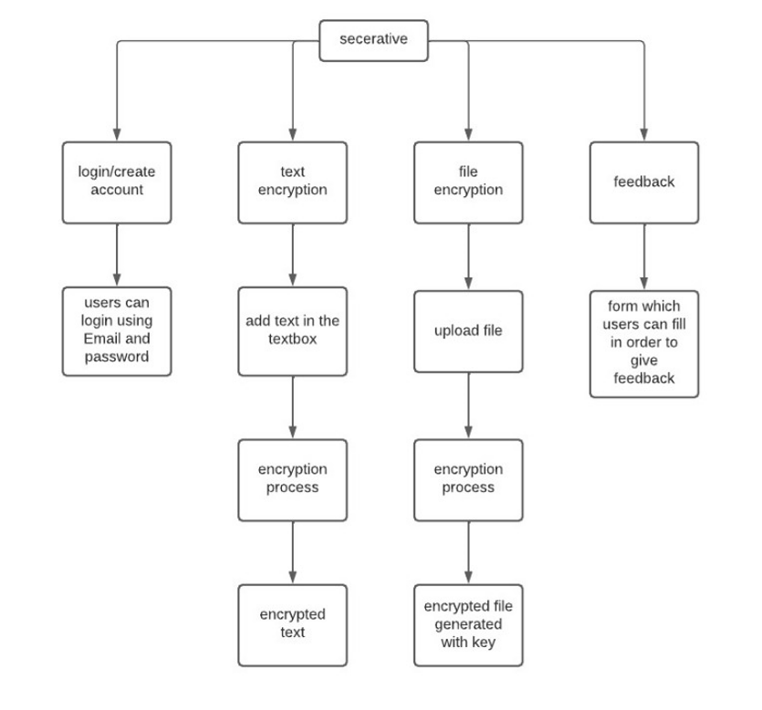
4.2 Flow-Chart

Slide 14
Thank You

